Slide 1
Stellar Profiles of Massive Galaxies: HSC vs. Hydro Simulations
Felipe Ardila
5/22/2018

Slide 2
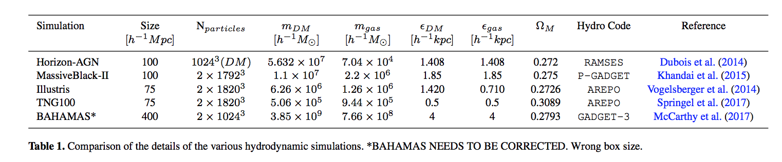
Hydrodynamic Simulations

Slide 3
Stellar Mass definitions
M*^{cat} : catalog mass, given from the sum of all particles bound to the subhalo. In Illustris and TNG the stellar mass of each particle is given by the initial particle mass multiplied by a mass loss function for that particle.
M*^{post} : “postage stamp” mass, given by summing over the mass map of the central galaxy only.
M*^{1d, extrap} : extrapolated mass from 1d profile, given by integrating a power law surface brightness profile (fit between 50 and 100kpc) out to the size of maps (800kpc)
M*^{1d, 30} (M*^{1d, 100}) : given by integrating 1d profile to 30kpc (100kpc)
M*^{2d, 30} (M*^{2d, 100}) : given by summing mass within 2d elliptical aperture of 30kpc (100kpc) semi-major axis

Slide 4
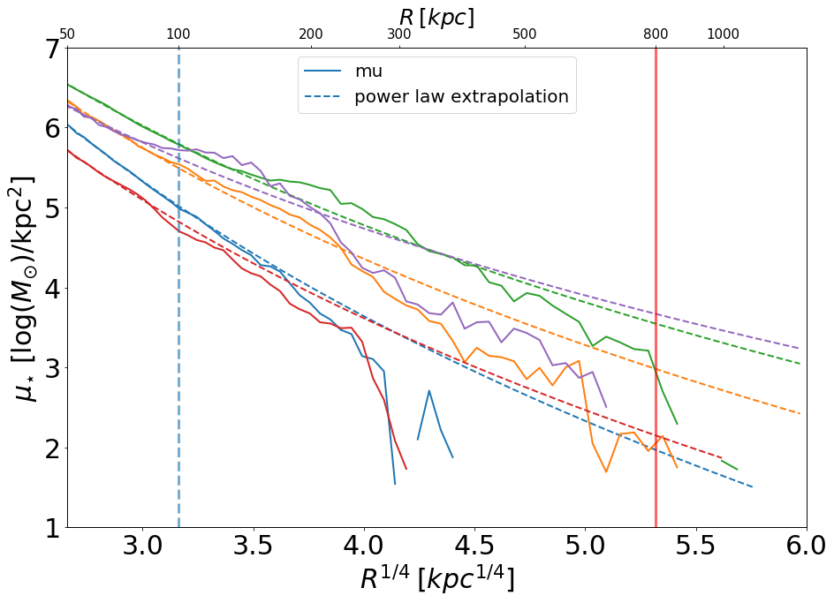
Extrapolated Mass

Slide 5
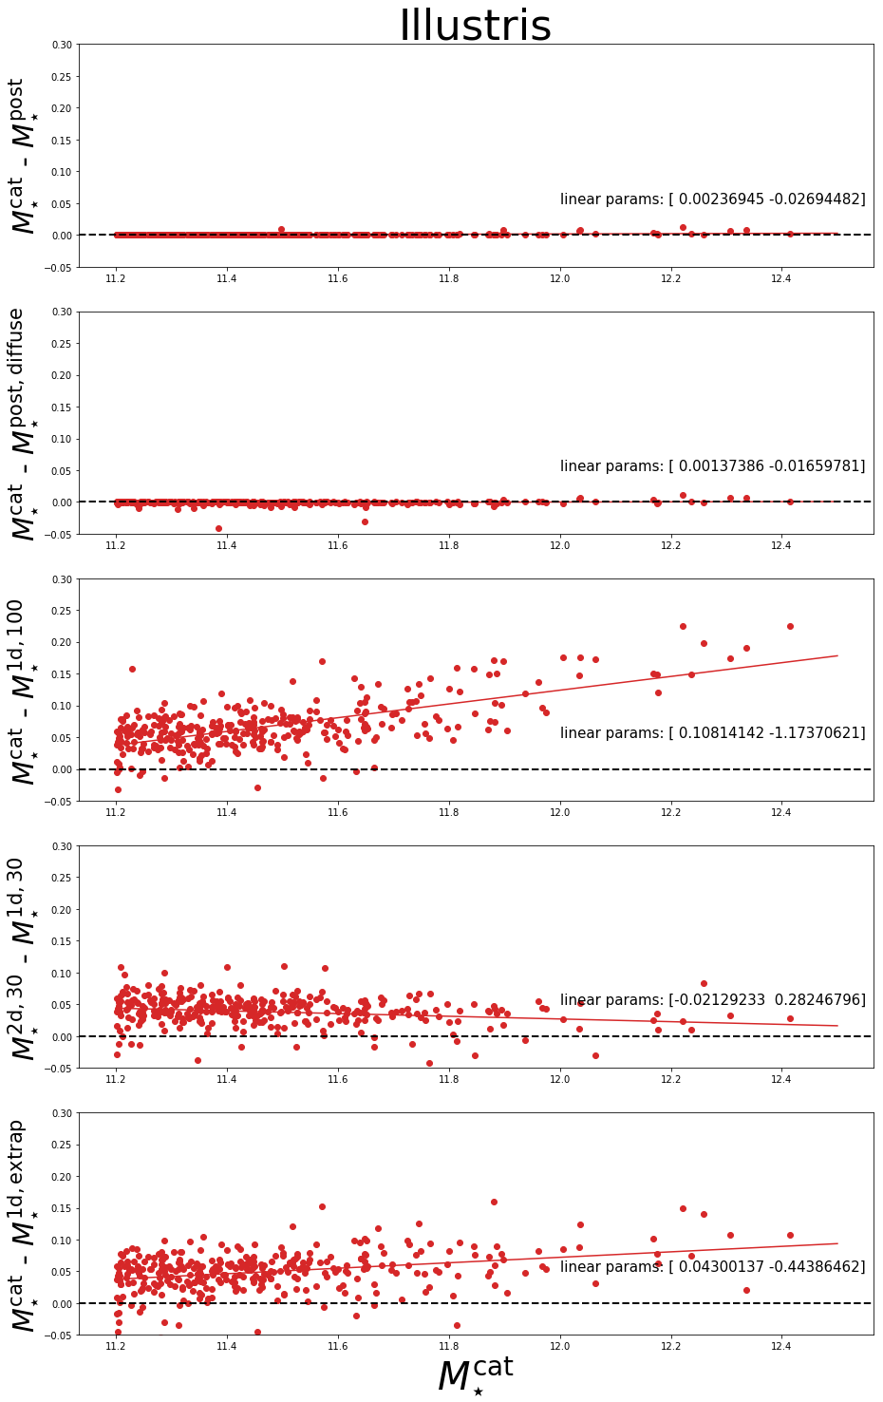
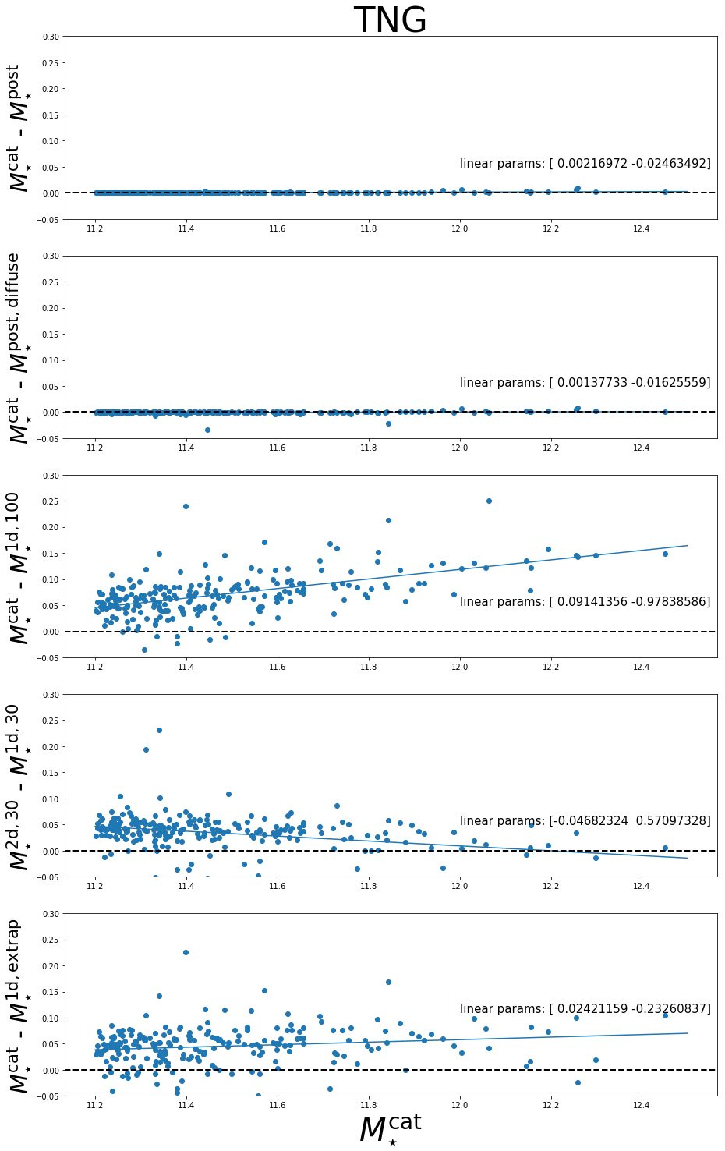

Slide 6
Matched to HSC by M*^{1d, 100}

Slide 7
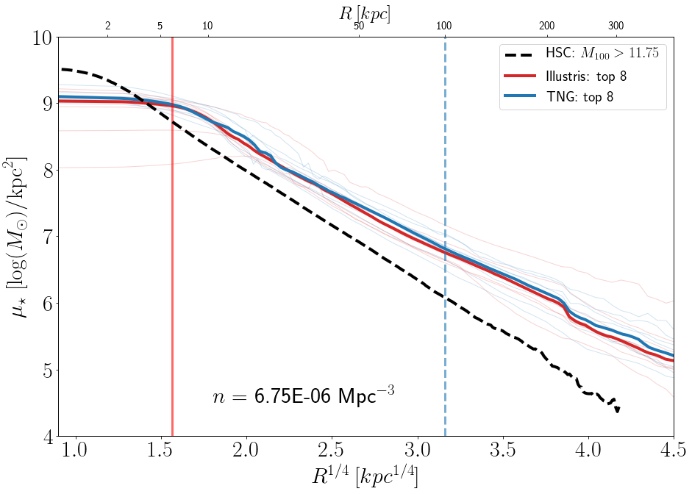
Matched to HSC by number density

Slide 8
Stellar Mass Functions

Slide 9
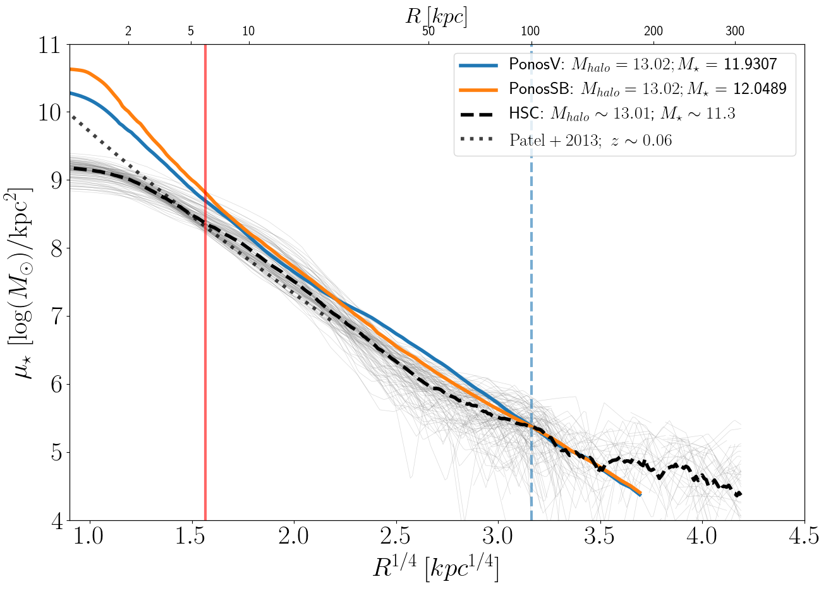
Higher Resolution

